Slide 1
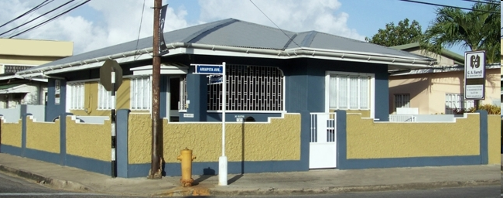
G.A. Farrell & Associates Limited CHARTERED VALUATION AND QUANTITY SURVEYORS

Slide 2
G.A. Farrell & Associates Limited
Proud to be part of Professional Seminar put on by The ASSOCIATION OF REAL ESTATE AGENTS-AREA
In this seminar are some of our clients who are leaders in –
The Real Estate Sales Industry
The Banking Industry

Slide 3
G.A. Farrell & Associates Limited
These leaders are at the forefront of their respective industries due to hard work and sound business practices.
In making business decisions, they rely, from time-to-time, on the professional advise of others who they trust implicitly.

Slide 4
G.A. Farrell & Associates Limited
Some of the professionals on whom they rely include - - Attorneys
Quantity Surveyors
Valuers

Slide 5
G.A. Farrell & Associates Limited
Professional Firm with over 35 years experience locally as well as in the UK & USA.
Professional and Qualified Valuers.
Quantity Surveyor Consultant.
Quick turnaround time and competitive fees.

Slide 6
G.A. Farrell & Associates Limited
Offices in –
Port of Spain
San Fernando
Chaguanas
Tobago
Miami (Affiliate)
Access to major international appraisal firms –
Cushman & Wakefield
HVS

Slide 7
G.A. Farrell & Associates Limited
Our Clients include the leading companies in
Finance
Manufacturing
Property Development
Leisure Industry

Slide 8
G.A. Farrell & Associates Limited
Financial Institutions
Colonial Life Ins. Co (T) Ltd.
Others
Manufacturing
ABEL
Shopping Centres
Carlton Centre
First Citizens Bank Limited
Home Mortgage Bank
Intercommercial Bank Limited
Republic Bank Ltd
Guardian Holdings Ltd
RBTT Bank Ltd
Sagicor
National Ins. Board of T &
Scotiabank T & T Ltd
Carib Brewery
Caribbean Steel Mills Lts.
Flavorite Foods Ltd.
Consolidated Appliances Ltd.
Trinidad & Tobago Manufacturer’s Association
TRINRICO
Carib Glassworks Ltd.
Pres-T-Con Ltd.
Bestcrete
Cross Crossing
Gulf View
Mid-Centre
Westmall
Ansa Mcal Ltd.
British High Commission
Carlton Savannah
Mount Irvine Bay Hotel
Oilfield Workers Trade Union
Home Construction Limited
BP T&T LLC

Slide 9
G.A. Farrell & Associates Limited
Our Valuation Reports include:
Neighbourhood Descriptions
Aerial Photographs
Site & Building Details.
Location Plan and Building sketch
Photographs
Analysis of Market Conditions

Slide 10
G.A. Farrell & Associates Limited
We constantly update our analysis of Market conditions on our Website - http://www.gafarrell.com:
We also offer our clients a free estimate of the closing costs on their loan

Slide 11
G.A. Farrell & Associates Limited
Our MISSION STATEMENT states that
G.A. Farrell & Associates Limited will be consistently client focused in the provision of objective, independent opinions on which our clients can rely in making their financial decisions. Our team is committed to the highest level of professional conduct and uncompromising integrity.

Slide 12
G.A. Farrell & Associates Limited
THANK YOU VERY MUCH

